Slide 1
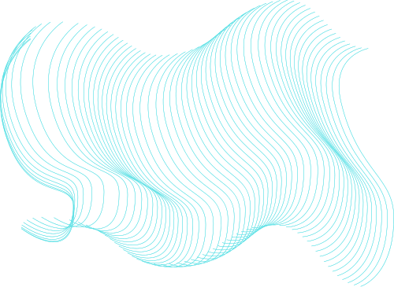

Domain Adaptation Techniquesfor
Real-World Glaucoma Screening
CS3811 – PROJECTWORK
Final Review (30.05.2025)
Guided By:
Dr. R. Balamurugan (ASP/CSE)
By,
Santhosh S (953621104035)
Karthikeyan PS (953621104021)

Slide 2
Introduction
Glaucoma is a leading cause of irreversible blindness worldwide, often progressing silently until significant vision loss has occurred.
Early detection through fundus imaging is critical, but manual diagnosis is time-consuming, expertise-dependent, and not easily scalable.
Image quality variability across different screening centers, especially in rural and telemedicine setups, poses a challenge for consistent AI performance.
Recent advances in deep learning and computer vision have shown promising results in medical image analysis, enabling automated disease detection.
This project proposes a deep learning-based glaucoma screening system using GANs, domain adaptation, EfficientNet-B0, and Vision Transformers to provide accurate, scalable, and robust diagnosis from color fundus images.

Slide 3
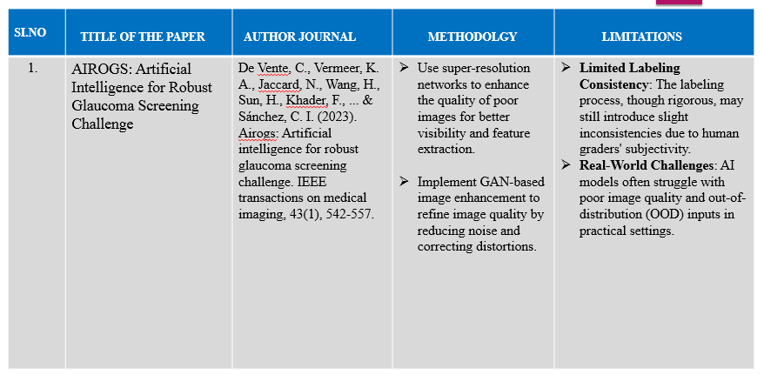
LITERATURE SURVEY

Slide 4
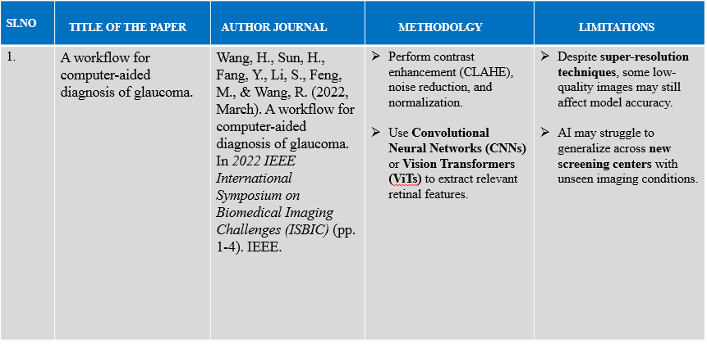
LITERATURE SURVEY

Slide 5
Objectives
To develop an automated glaucoma screening system using deep learning techniques for early and accurate detection from color fundus images.
To enhance image quality using super-resolution and GAN-based methods, ensuring reliable performance across low-quality and noisy images.
To implement domain adaptation strategies that allow the model to generalize effectively across images from different sources and screening environments.
To integrate EfficientNet-B0 and Vision Transformers for efficient feature extraction and improved classification accuracy.

Slide 6

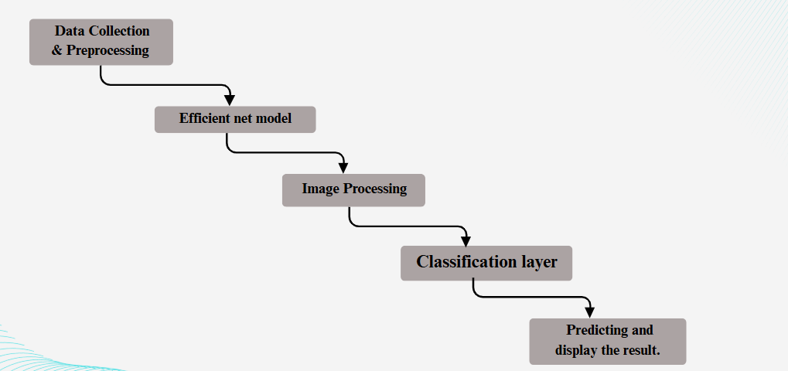
Work Flow

Slide 7
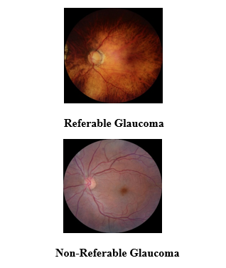
Dataset
Zenodo Dataset:
The Zenodo dataset contains the following key components:
Document Images
High-resolution images of Retinal images.
Pages contains full of Retinal images for the glaucoma processing.
Annotations & Ground Truth
Contains detailed of the images as RG & NRG.
Each document is labeled with the retinal image.
Training, and Test Splits
The dataset is split into:
RG (Referable glaucoma)
NRG (Non Referable glacuoma)

Slide 8
Hardware and Software used
Hardware Used
Pentium Dual Core 2.00 GHz Processor
120 GB Hard Disk
2 GB RAM (Minimum)
110 Keys Enhanced Keyboard
Software Used
Operating System: Windows 7 (with Service Pack 1), Windows 8, 8.1, or 10
Programming Language: Python
Libraries/Frameworks: TensorFlow / PyTorch (for deep learning)
Image Processing: OpenCV, PIL (Python Imaging Library)
Jupyter Notebook / Google Colab (for development and testing)
IDE: Visual Studio Code / PyCharm (optional)

Slide 9
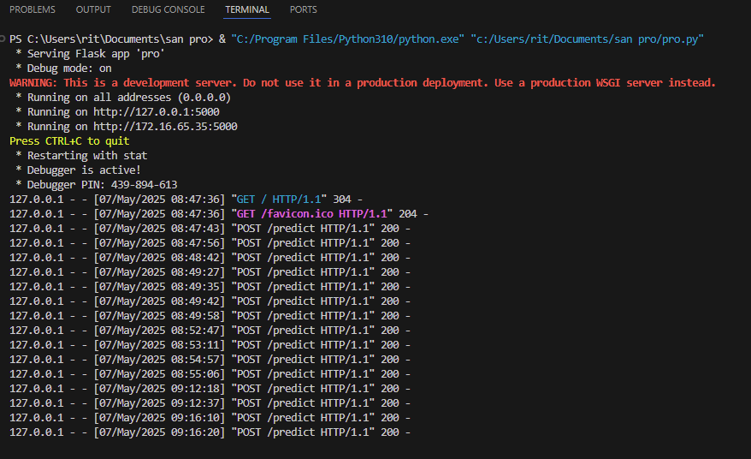
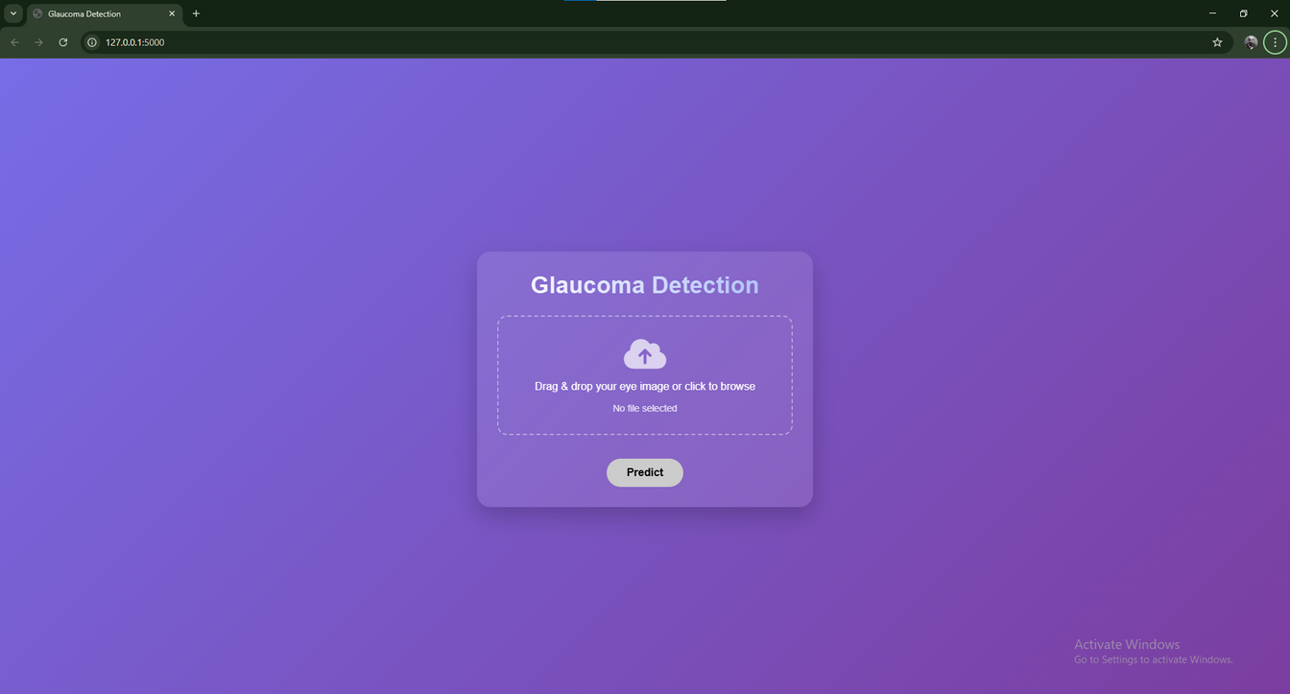
Implementation

Slide 10
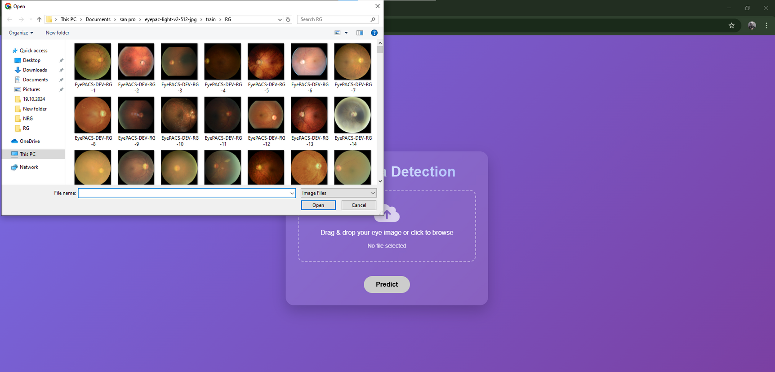
Implementation

Slide 11
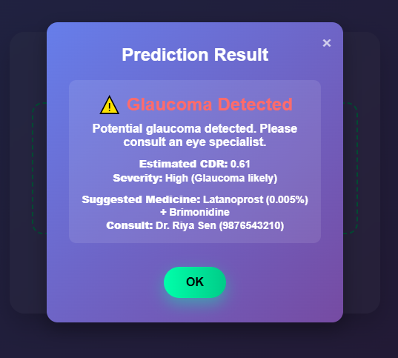
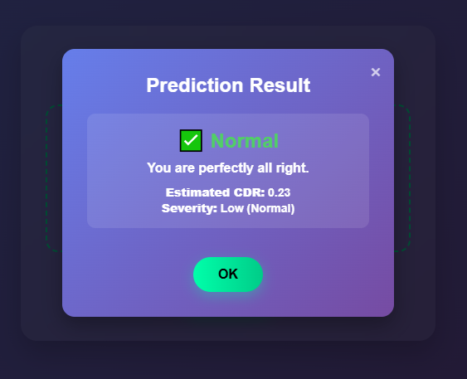
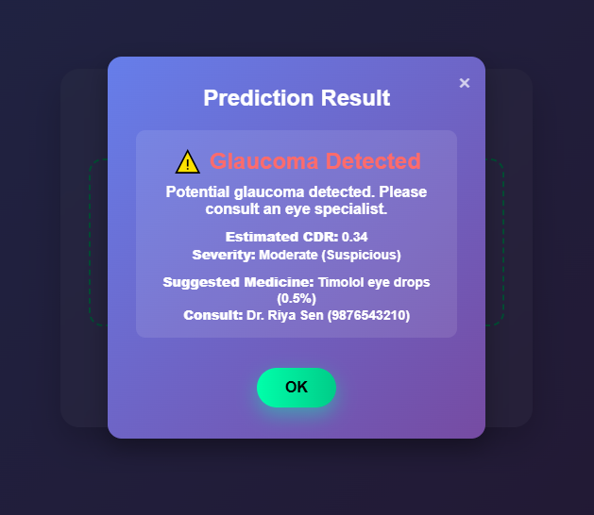
Results

Slide 12
Conclusion
This project successfully demonstrates the development of a deep learning-based glaucoma screening system capable of delivering accurate and early diagnosis from color fundus images. By integrating advanced techniques such as super-resolution, GAN-based enhancement, and domain adaptation, the model effectively addresses challenges posed by image quality variability and domain shifts.
Future Work
Integration of Multimodal Data: Incorporate additional clinical data such as intraocular pressure, patient history, and OCT scans to improve diagnostic accuracy.
Real-Time Deployment: Optimize the model for deployment in mobile or edge devices to enable real-time glaucoma screening in rural and under-resourced areas.
Explainable AI (XAI): Implement interpretable models or visualization techniques (e.g., Grad-CAM, SHAP) to help clinicians understand the model’s decision-making process.

Slide 13
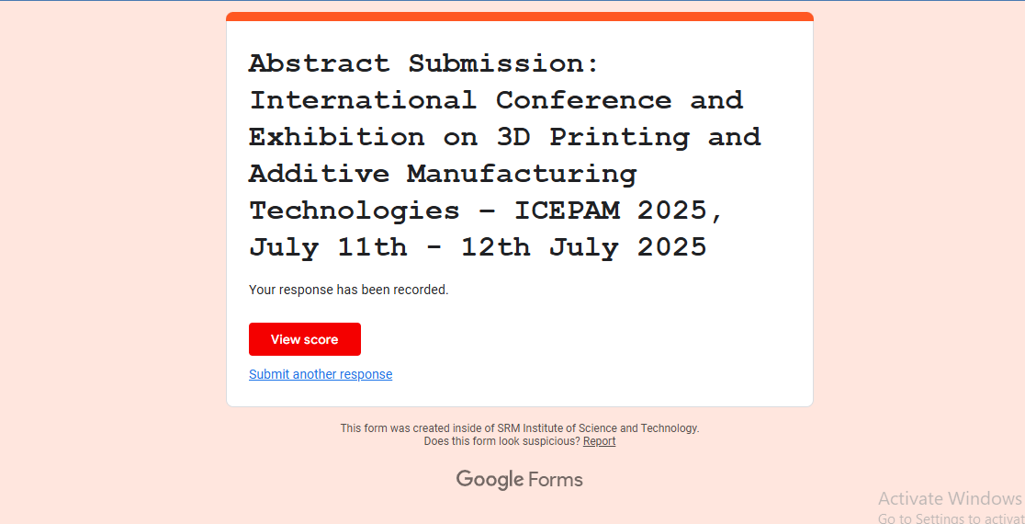
Confrence

Slide 14
References
F. Khader, “Elevating fundoscopic evaluation to expert level–automatic glaucoma detection using data from the AIROGS challenge,” Mar. 2022, pp. 1–4.
A. Dosovitskiy, “An image is worth 16×16 words: Transformers for image recognition at scale,” arXiv preprint arXiv:2010.11929, 2020.
G. Huang, Z. Liu, L. Van Der Maaten, and K. Q. Weinberger, “Densely connected convolutional networks,” in Proc. IEEE Conf. Comput. Vis. Pattern Recognit., Jul. 2017, pp. 2261–2269.
A. Galdran, G. Carneiro, and M. A. G. Ballester, “Open-set glaucoma screening from eye fundus images: Domain knowledge to the rescue,” 2022.
K. He, X. Zhang, S. Ren, and J. Sun, “Deep residual learning for image recognition,” in Proc. IEEE Conf. Comput. Vis. Pattern Recognit., 2016, pp. 770–778.

Slide 15
Thank you

